Slide 1
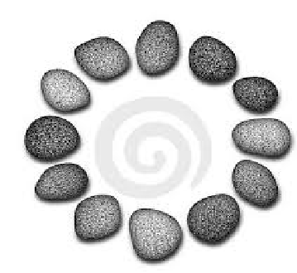

Password Hashing and Graph Pebbling
Samson Zhou
Joint work with:
Jeremiah Blocki*, Ben Harsha, Ling Ren

Slide 2
Structure of Talk
Economics of Password Hashing
Graph Pebbling and Evaluations
Computability of Graph Pebbling

Slide 3
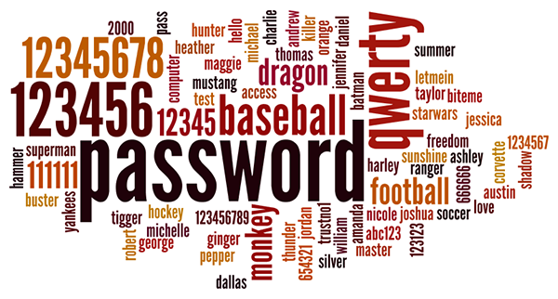
Background
Users tend to pick weak passwords

Slide 4
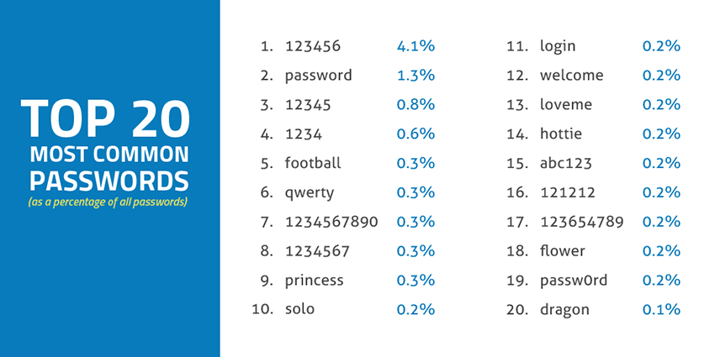
Source: SkyHigh

Slide 5

Background
Users tend to pick weak passwords
Server attacks are inevitable

Slide 6
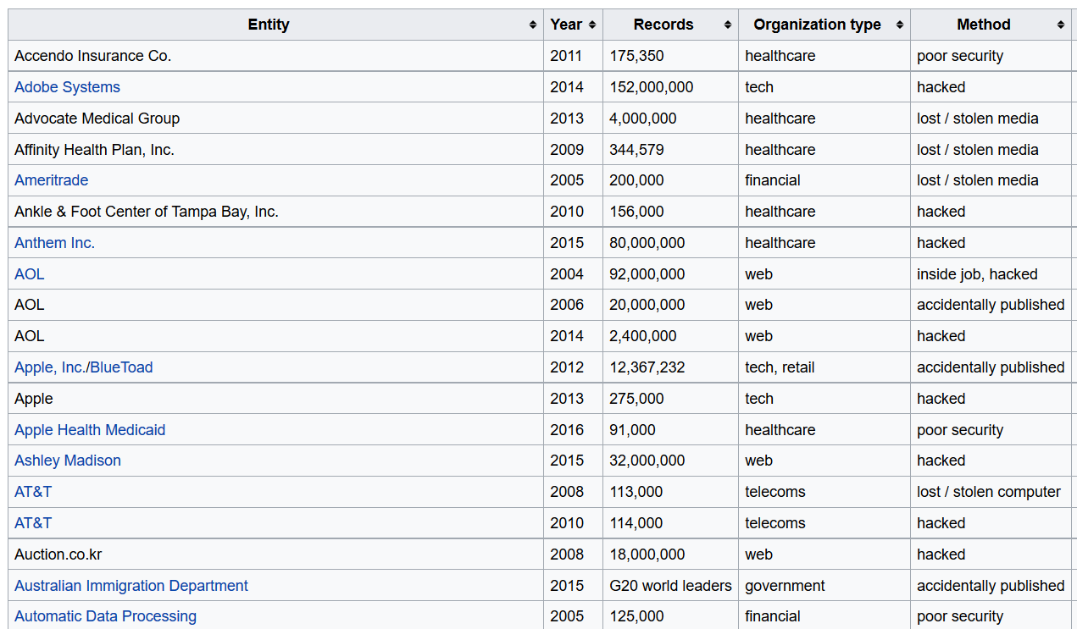

Slide 7
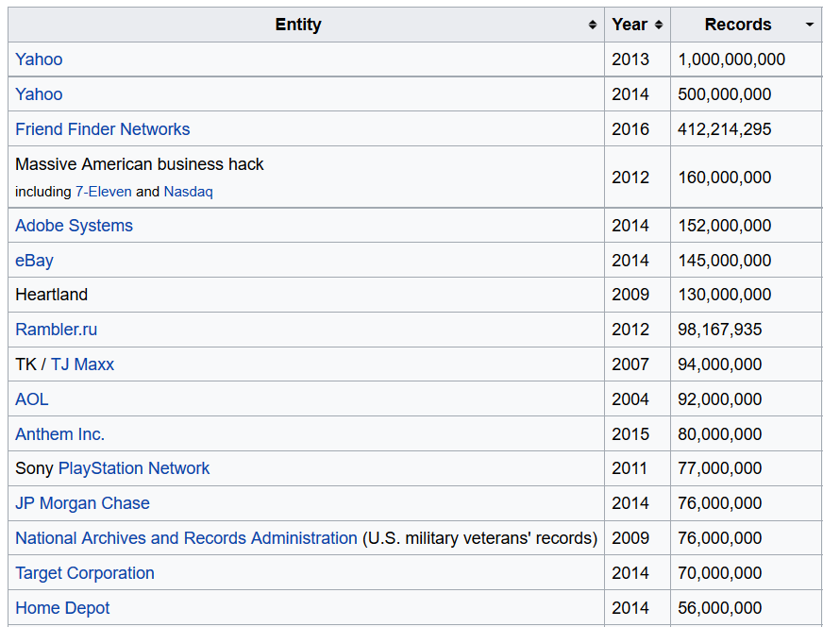

Slide 8












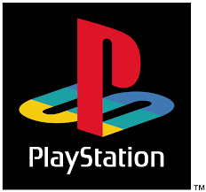


Slide 9





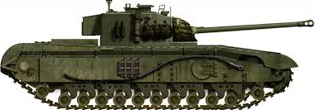

Slide 10
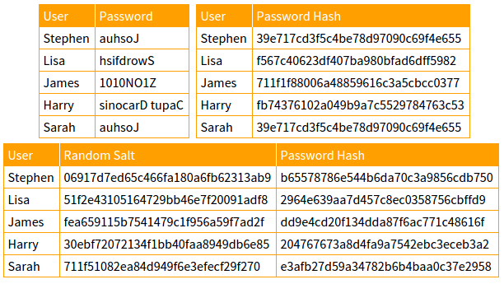

Slide 11
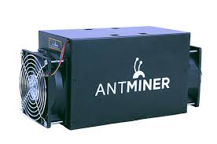
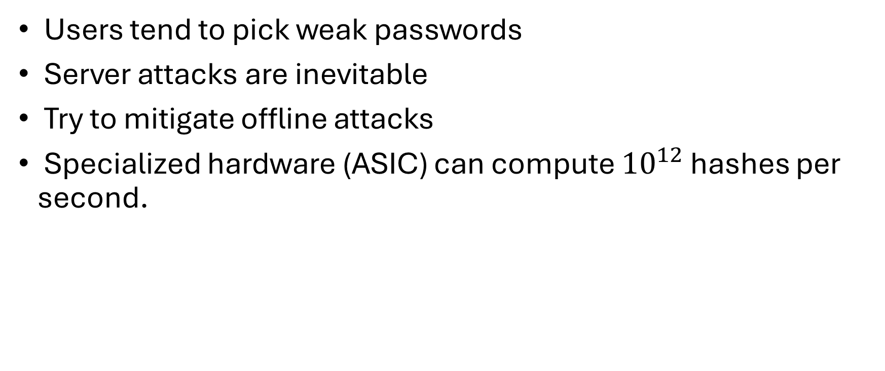
Motivation
Users tend to pick weak passwords
Server attacks are inevitable
Try to mitigate offline attacks
Specialized hardware (ASIC) can compute ${10}^{12}$ hashes per second.

Slide 12

Password Hash Function Goals
“Moderately Expensive” to compute
Expensive to compute on ASIC
Fast and cheap on PC

Slide 13



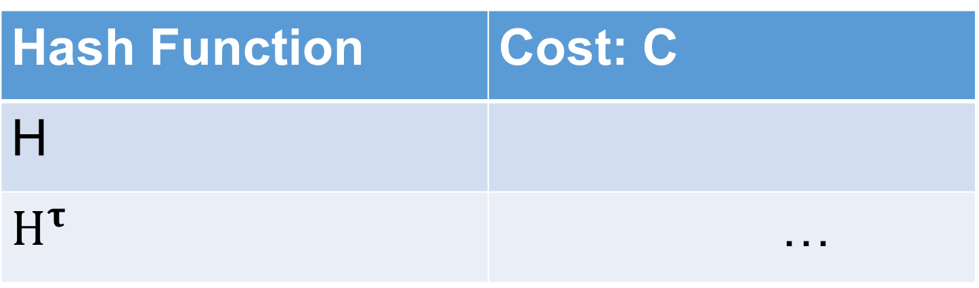
Key Stretching
Hash Function | Cost: C
H
$H^{τ}$ | …
Hash Iteration
Memory Hard Functions
PBKDF2

Slide 14
Strong Claims (Post Breaches)
“Cracking our algorithms [PBKDF2-SHA256] is extremely difficult, even for the strongest of computers.” – LastPass Blog
“The bcrypt hashing algorithm protecting it is very resilient to cracking and frankly, all but the worst possible password choices are going to remain secure even with the breach now out in the public…”
Can we predict how many users passwords a rational attacker will crack after a breach?

Slide 15
“Rational” Adversary
Rainbow attack / dictionary attack
Try iteratively guessing some common passwords
Stop once cost > revenue

Slide 16
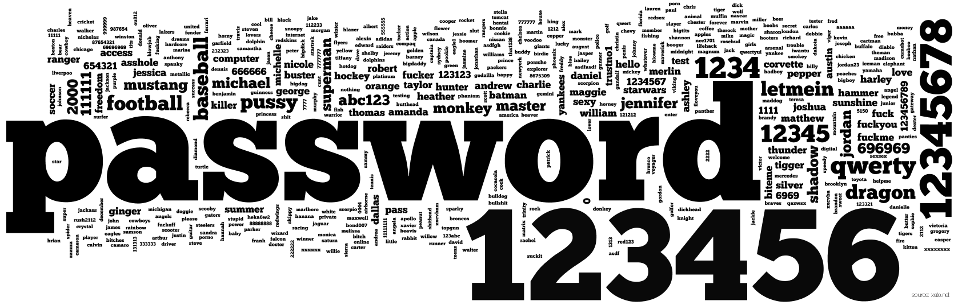

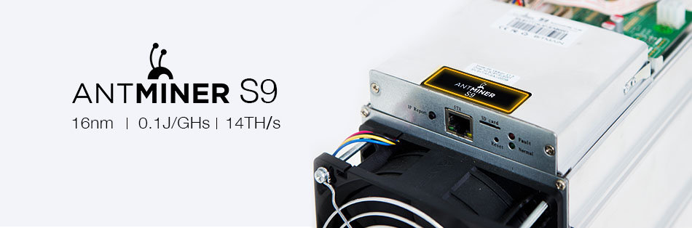
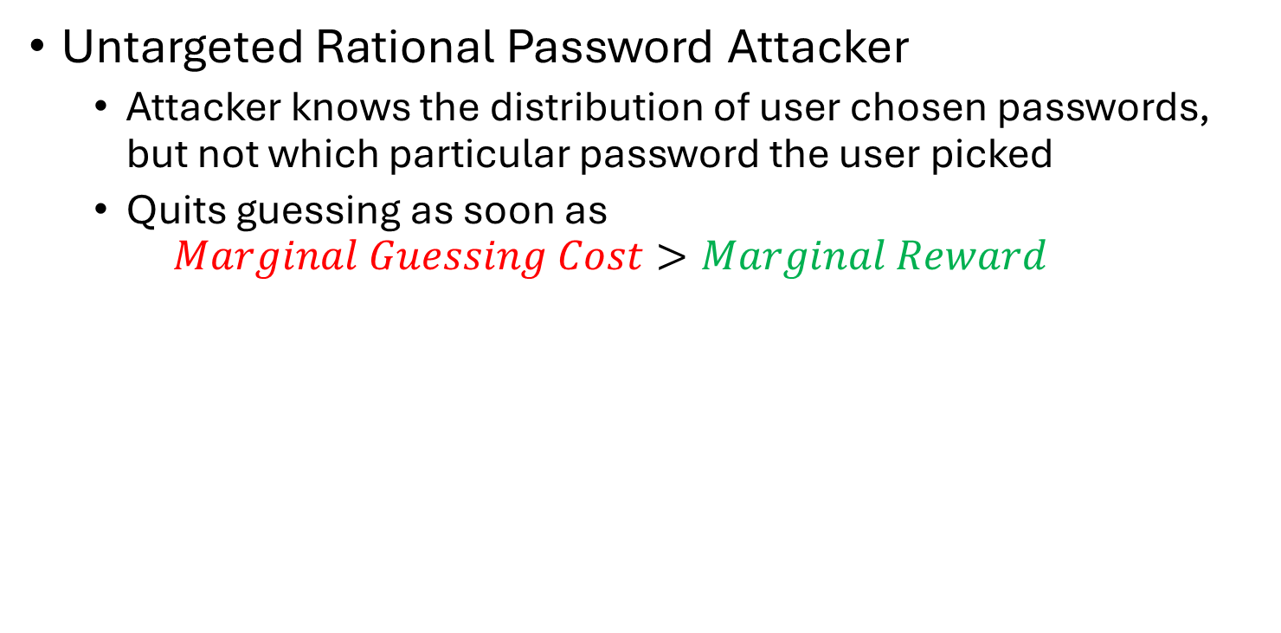
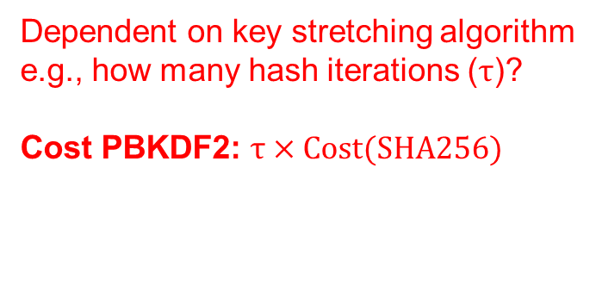
Decision Theoretic Model
Untargeted Rational Password Attacker
Attacker knows the distribution of user chosen passwords, but not which particular password the user picked
Quits guessing as soon as
$$Marginal Guessing Cost>Marginal Reward$$
Dependent on key stretching algorithm
e.g., how many hash iterations ($τ$)?
Cost PBKDF2: $τ×Cost(SHA256)$
$1,200

Slide 17
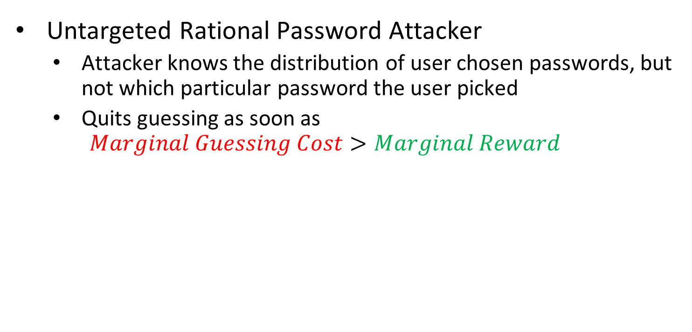
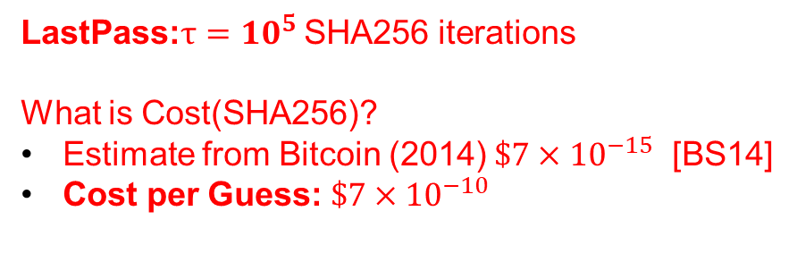
Decision Theoretic Model
Untargeted Rational Password Attacker
Attacker knows the distribution of user chosen passwords, but not which particular password the user picked
Quits guessing as soon as
$$Marginal Guessing Cost>Marginal Reward$$
LastPass:$τ={10}^{5}$ SHA256 iterations
What is Cost(SHA256)?
Estimate from Bitcoin (2014) $\$7×{10}^{−15}$ [BS14]
Cost per Guess: $\$7×{10}^{−10}$
$1,200

Slide 18
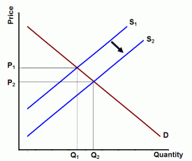

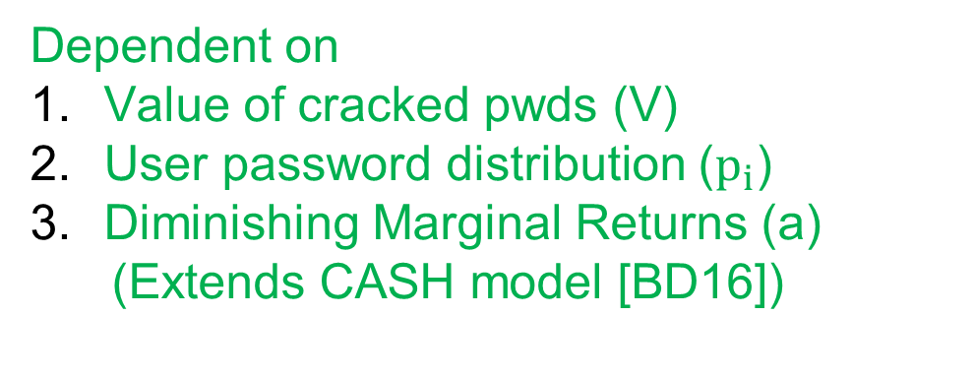
Decision Theoretic Model
Untargeted Rational Password Attacker
Attacker knows the distribution of user chosen passwords, but not which particular password the user picked
Quits guessing as soon as
$$Marginal Guessing Cost>Marginal Reward$$
Dependent on
Value of cracked pwds (V)
User password distribution ($p_{i}$)
Diminishing Marginal Returns (a)
(Extends CASH model [BD16])

Slide 19
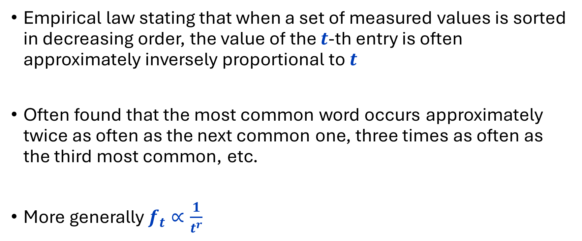
Zipfian Distributions (Zipf’s Law)
Empirical law stating that when a set of measured values is sorted in decreasing order, the value of the $t$-th entry is often approximately inversely proportional to $t$
Often found that the most common word occurs approximately twice as often as the next common one, three times as often as the third most common, etc.
More generally $f_{t}∝\frac{1}{t^{r}}$

Slide 20
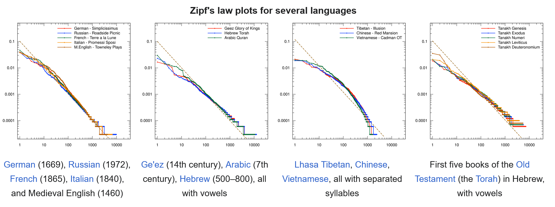
Zipfian Distributions (Zipf’s Law)
“Zipf’s law holds for most natural languages…the reason is still not well understood”
in the Brown Corpus of American English text, the word "the" is the most frequently occurring word, and by itself accounts for nearly 7% of all word occurrences (69,971 out of slightly over 1 million). True to Zipf's law, the second-place word "of" accounts for slightly over 3.5% of words (36,411 occurrences), followed by "and" (28,852)

Slide 21
Zipfian Distributions (Zipf’s Law)
In the Brown Corpus of American English text:
“The” is the most frequently occurring word, accounting for ~7% of all words (69,971 out of slightly over 1 million)
True to Zipf's law, the second-place word "of" accounts for slightly over 3.5% of words (36,411 occurrences)
Followed by "and" (28,852)

Slide 22
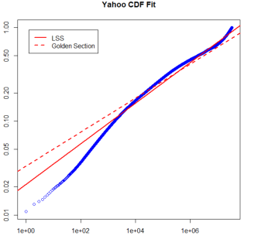
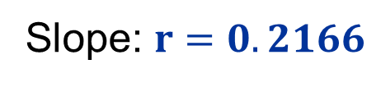

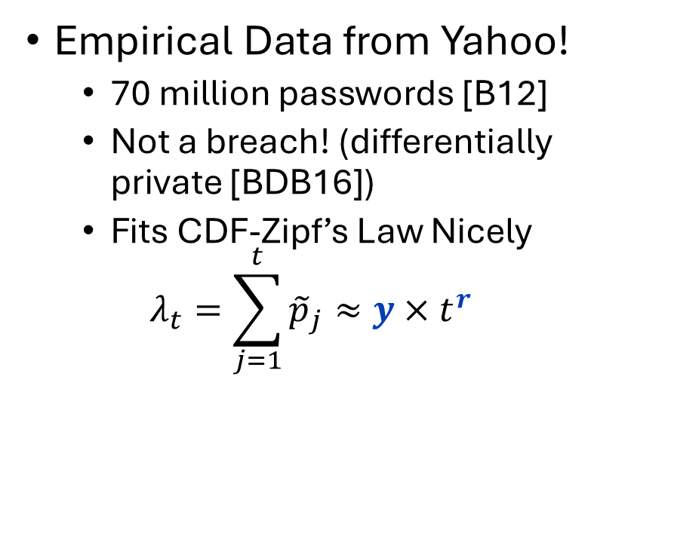
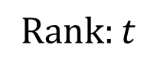
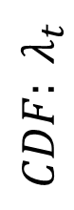
User Password Distribution
Empirical Data from Yahoo!
70 million passwords [B12]
Not a breach! (differentially private [BDB16])
Fits CDF-Zipf’s Law Nicely
$$λ_{t}=\sum_{j=1}^{t}{{\tilde{p}}_{j}}≈y×t^{r}$$
$${CDF: λ}_{t}$$
Slope: $r=0.2166$
$$y=0.0211$$
$$Rank:t$$

Slide 23
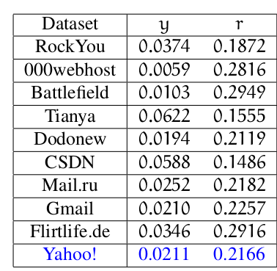
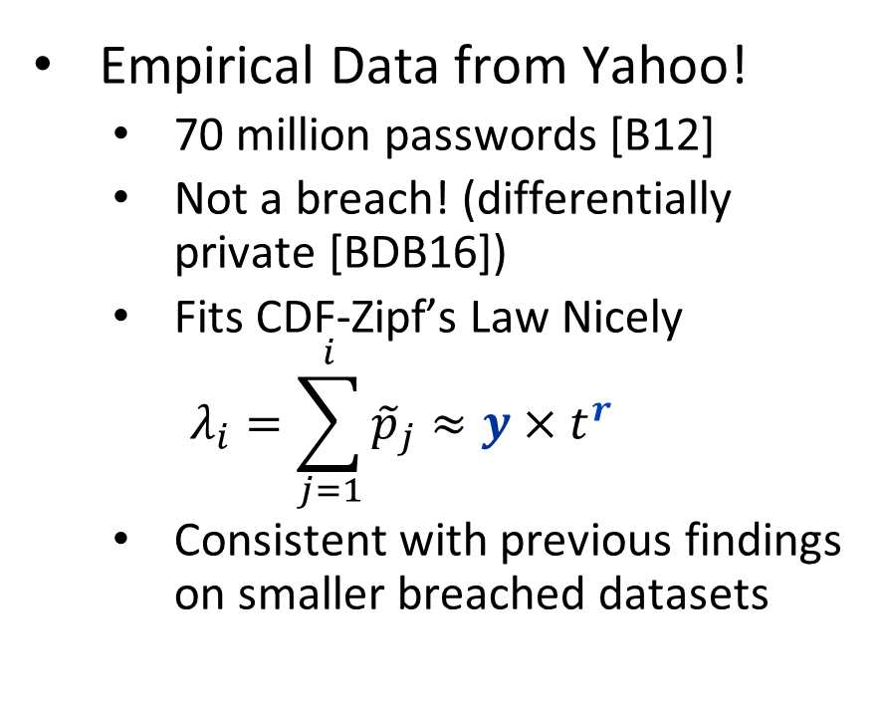
User Password Distribution
Empirical Data from Yahoo!
70 million passwords [B12]
Not a breach! (differentially private [BDB16])
Fits CDF-Zipf’s Law Nicely
$$λ_{i}=\sum_{j=1}^{i}{{\tilde{p}}_{j}}≈y×t^{r}$$
Consistent with previous findings on smaller breached datasets
Wang et al. [WCWHJ17]
Our Result: CDF-Zipf’s Law Parameters (y,r) for Yahoo!

Slide 24
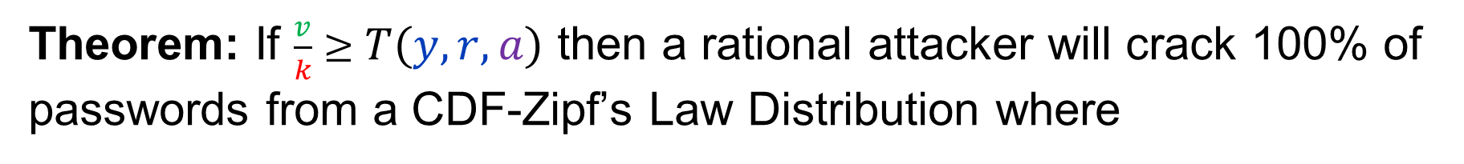
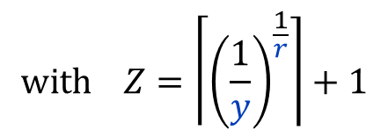
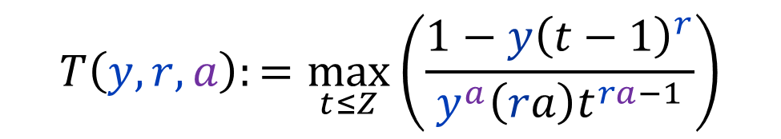
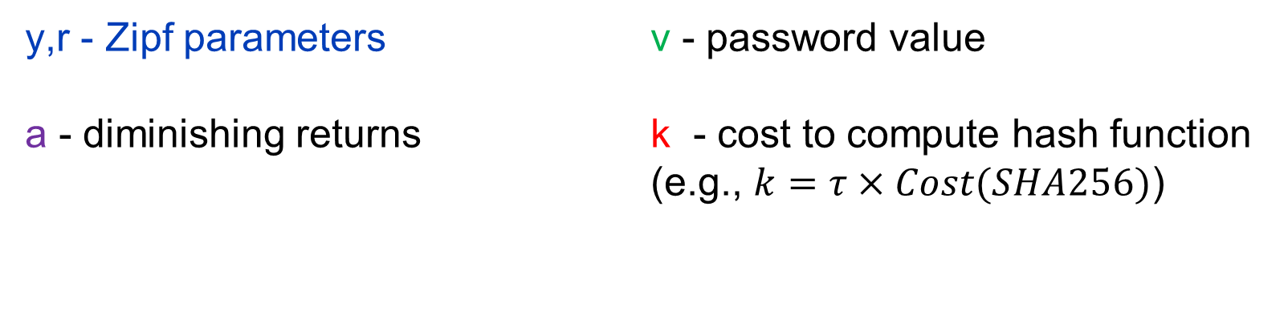
Threshold Function of Doom
Theorem: If $\frac{v}{k}≥T\left(y,r,a\right)$ then a rational attacker will crack 100% of passwords from a CDF-Zipf’s Law Distribution where
$$T\left(y,r,a\right):=\max_{t≤Z}\left(\frac{1−y{\left(t−1\right)}^{r}}{y^{a}{\left(ra\right)t}^{ra−1}}\right)$$
$$with Z=\left\lceil {\left(\frac{1}{y}\right)}^{\frac{1}{r}}\right\rceil +1$$
y,r - Zipf parameters
a - diminishing returns
v - password value
k - cost to compute hash function (e.g., $k=τ×Cost(SHA256)$)

Slide 25
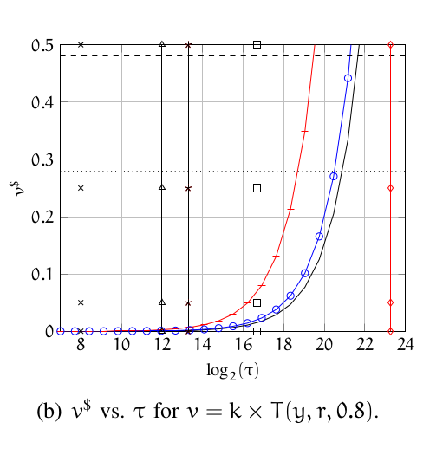
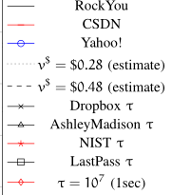
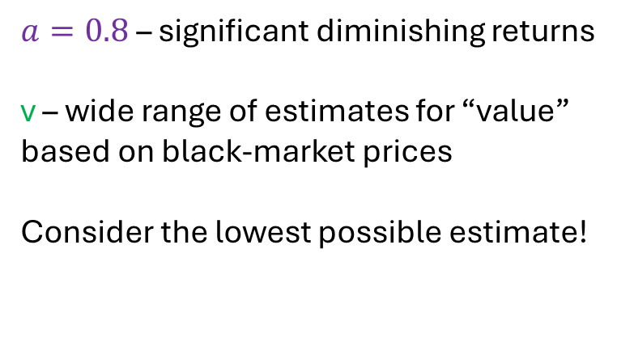
An “Optimistic” Picture
$a=0.8$ – significant diminishing returns
v – wide range of estimates for “value” based on black-market prices
Consider the lowest possible estimate!
DOOM ZONE
NIST Recommendations
LastPass

Slide 26
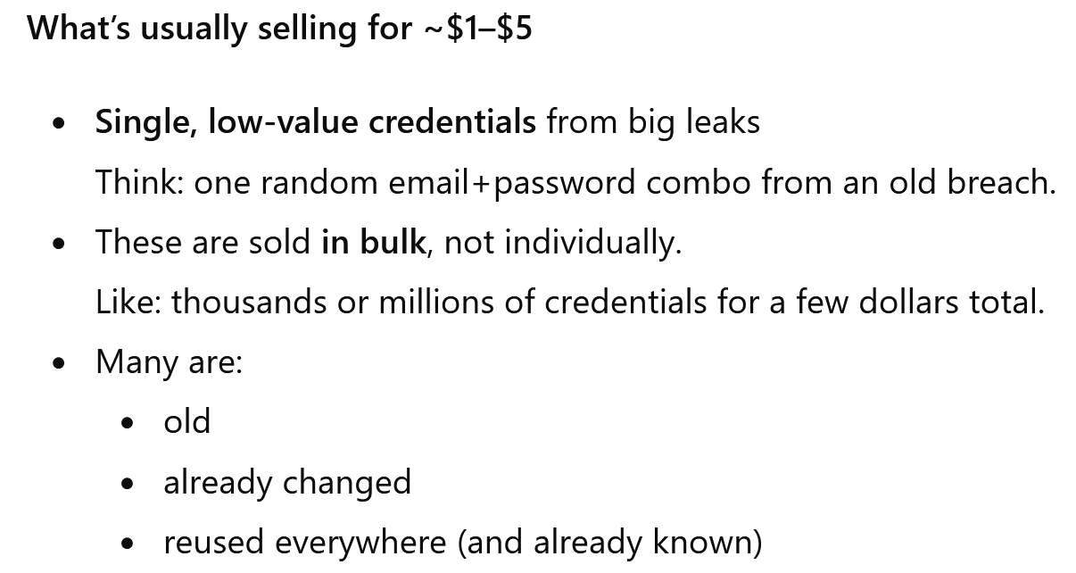
Password Values?
Average of $5 on the black-market in 2017???
ChatGPT:

Slide 27
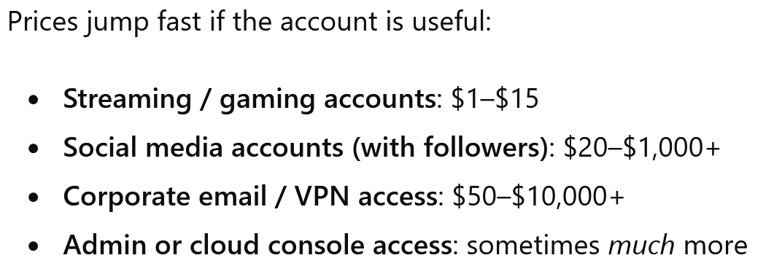
Password Values?

Slide 28
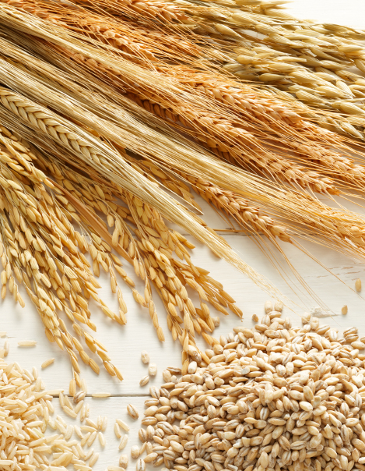
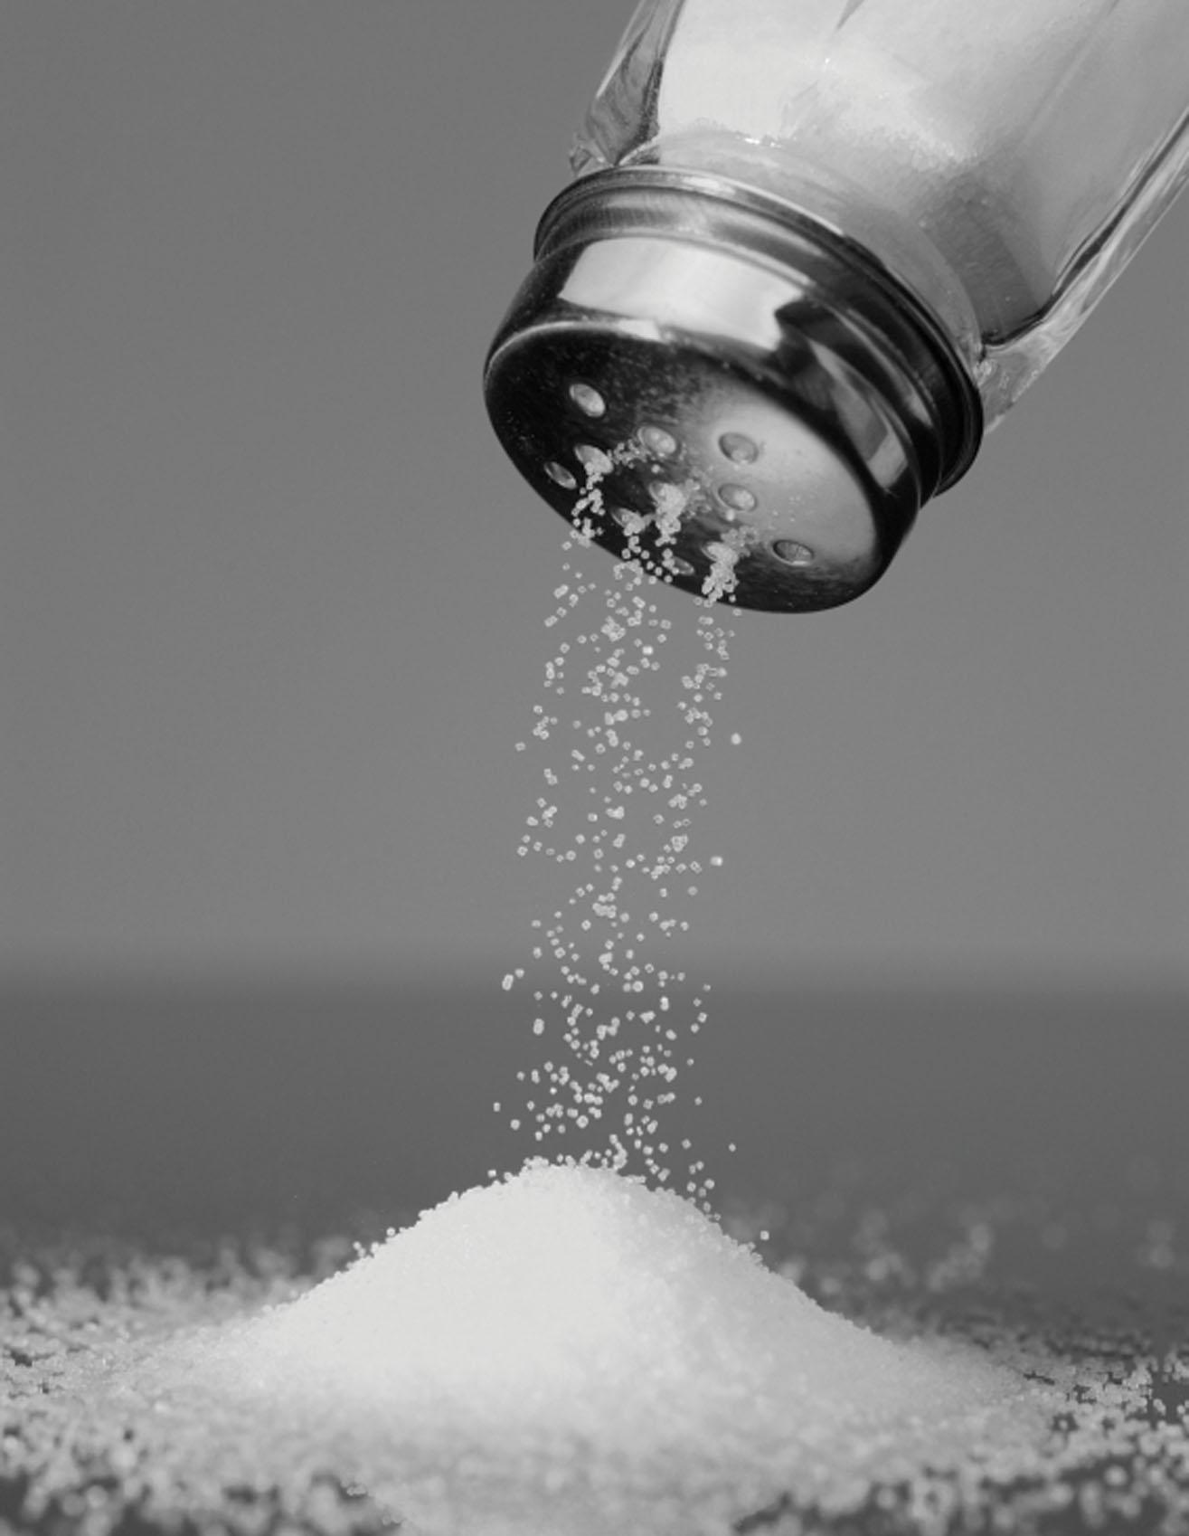
A Grain of Salt
Even if we make no assumptions about the shape of the password distribution, we can still argue that the attacker cracks most passwords with high probability.
(Chernoff Bounds)
While CDF-Zipf’s law fits empirical datasets nicely, we cannot be certain that it models the tail of the distribution.
At minimum attacker cracks all passwords that do follow Zipf’s Law (it is possible that some passwords from the tail of the distribution won’t be cracked)
How big is the tail of the distribution?
LinkedIn: Only 14% of passwords unique.
Source: https://www.troyhunt.com/86-of-passwords-are-terrible-and-other-statistics/

Slide 29
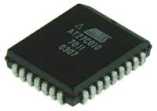
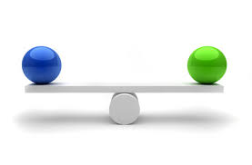


Slide 30
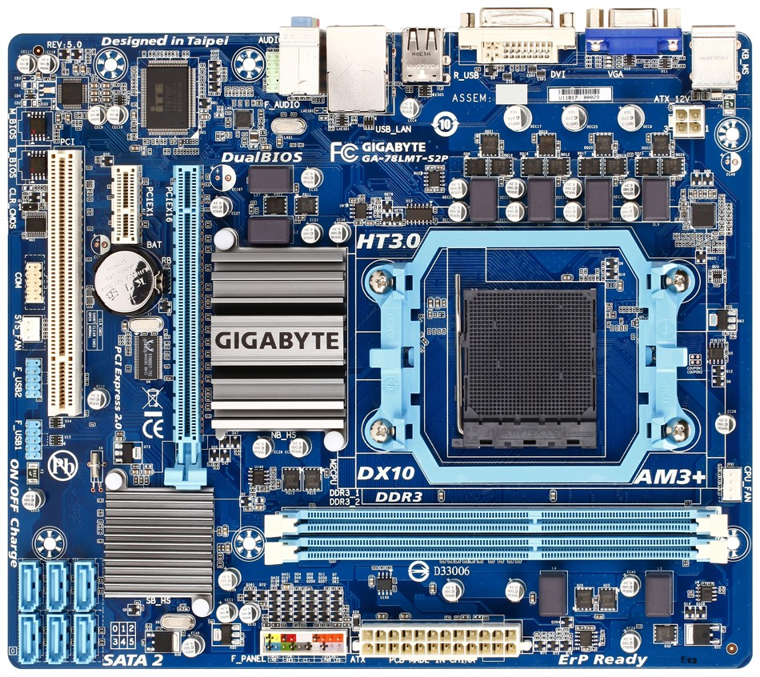
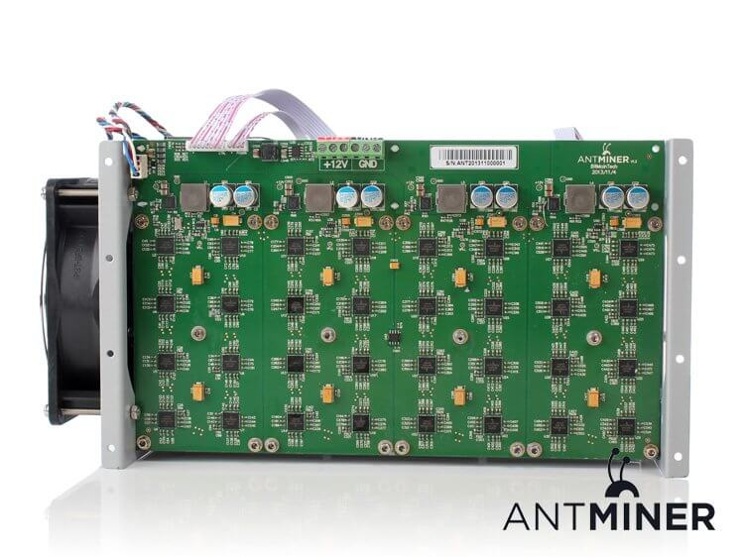

Slide 31
Memory Hard Functions
Memory hard functions require comparatively more resources for adversaries to compute
Data-dependent memory hard functions are susceptible to side-channel attacks
Data-independent memory hard functions (iMHFs)

Slide 32
iMHFs
$$f_{G,H}$$
Hash function: $H$

Slide 33
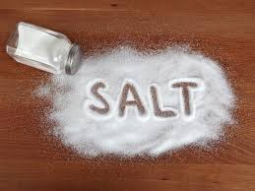
iMHFs
$$f_{G,H}$$
pwd
$$h_{1}$$
$$h_{1}=H(pwd, salt)$$

Slide 34
iMHFs
$$f_{G,H}$$
pwd
$$h_{1}$$
$$h_{2}$$
$$h_{2}=H(h_{1})$$

Slide 35
iMHFs
$$f_{G,H}$$
pwd
$$h_{1}$$
$$h_{2}$$
$$h_{3}$$
$$h_{4}$$
$$h_{3}=H\left(h_{1},h_{2}\right), { h}_{4}=H(h_{2})$$

Slide 36
iMHFs
$$f_{G,H}$$
pwd
$$h_{1}$$
$$h_{2}$$
$$h_{3}$$
$$h_{5}$$
$$h_{4}$$
$$h_{5}=H\left(h_{3},h_{4}\right)$$

Slide 37
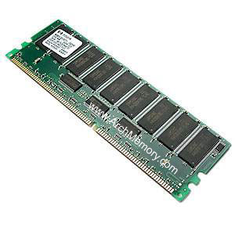


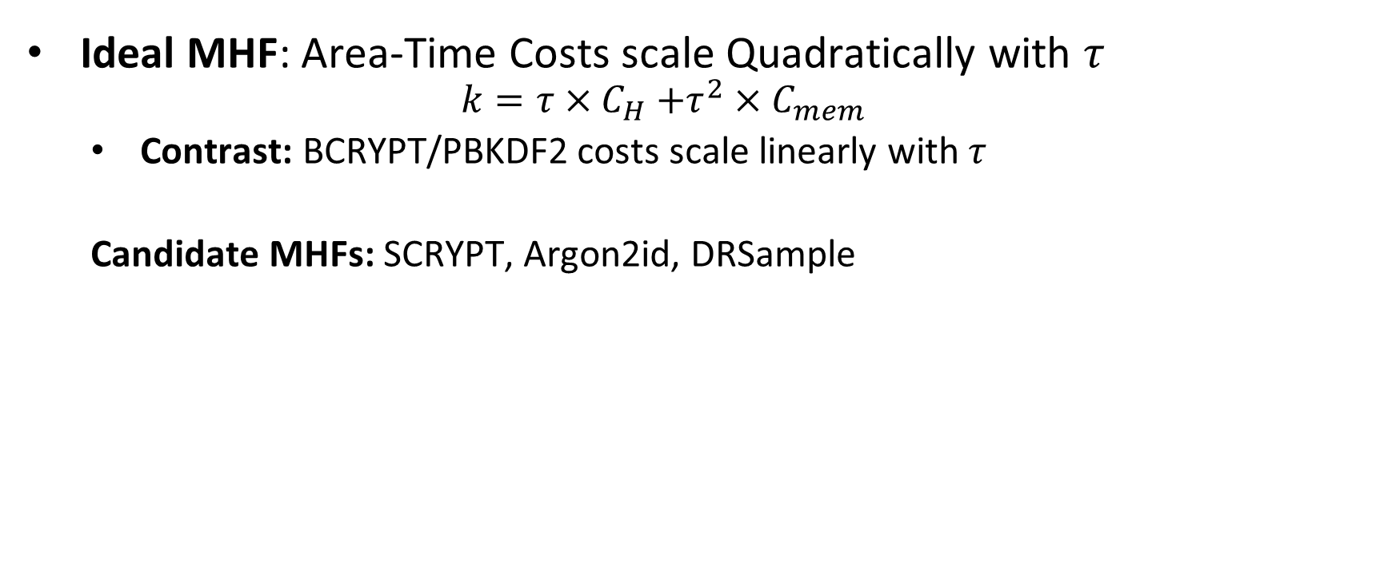
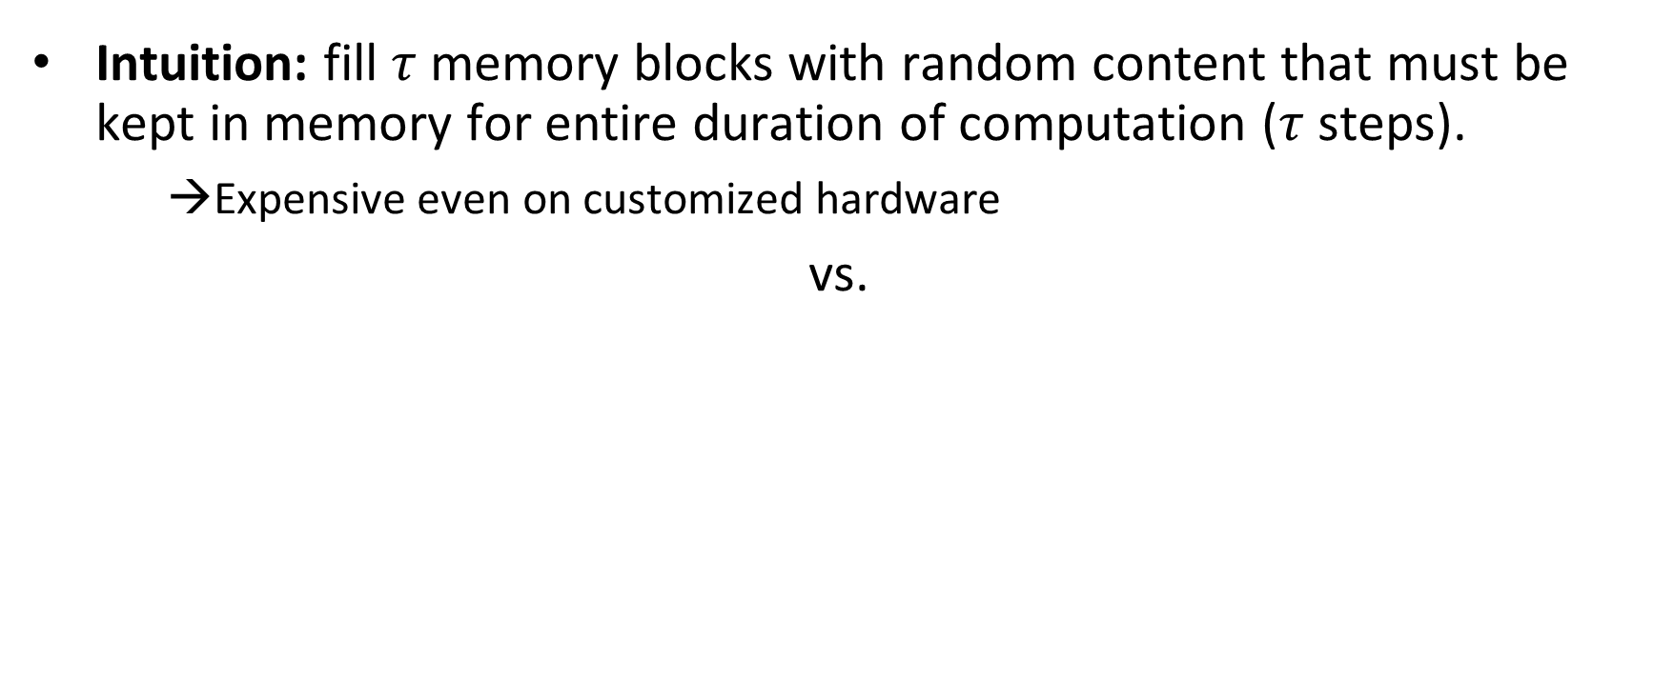
Memory Hard Functions (MHF)
Intuition: fill $τ$ memory blocks with random content that must be kept in memory for entire duration of computation ($τ$ steps).
→Expensive even on customized hardware
vs.
Ideal MHF: Area-Time Costs scale Quadratically with $τ$
$$k=τ{×C}_{H}+τ^{2}×C_{mem}$$
Contrast: BCRYPT/PBKDF2 costs scale linearly with $τ$
Candidate MHFs: SCRYPT, Argon2id, DRSample
Notes:
In this work we study a special type of memory hard function called data-independent memory hard functions. As the name suggests the memory access pattern will not depend on the input making the functions resistant to side-channel attacks.

Slide 38
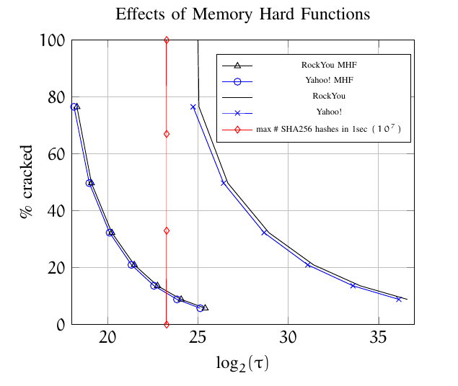
MHFs Are Helpful
“Pessimistic” Analysis
a=1
No Diminishing Marginal Returns (a=1)
v=$4
Value of cracked password is order of magnitude higher than in previous analysis
Quadratic Scaling: Less time required to give the same protection!
MHF: ~250ms
Non-MHF:~2 minutes

Slide 39


Executive Summary of Our Findings
BCRYPT/PBKDF2 provide insufficient protection for most user passwords!
Memory Hard Functions provide much stronger protection
SCRYPT, Argon2id, DRSample

Slide 40
Recommendations for Users
Enable Two-Factor Authentication
Focus energy on selecting different passwords for different accounts (as opposed to selecting more complex passwords)
Write down (part of) your passwords?
Example: (TAMU, szhou, ______3jtph$)

Slide 41
Structure of Talk
Economics of Password Hashing
Graph Pebbling and Evaluations
Computability of Graph Pebbling

Slide 42
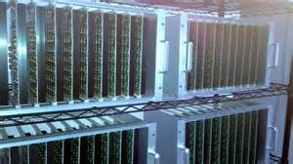

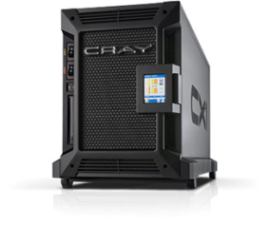






Goal: Moderately Expensive Hash Function
Fast on PC and
Expensive on ASIC?
Notes:
This motivates the need for moderately hard functions. The basic idea is to build a password hash function that is moderately expensive to compute to limit the number of guesses that an adversary would be willing to try. An honest server only needs to compute the function once during a typical authentication session. However, the adversary potentially has an advantage in this game. While the honest server must typically evaluate the function on standard hardware, the adversary could use potentially reduce the cost per password guess by developing customized hardware (GPUs, FPGAs, ASICs) to evaluate the password hash function. Thus, we want to ensure that the cost to evaluate this function is equitable across platforms.

Slide 43

(2013-2015)
https://password-hashing.net/

Slide 44

We recommend that you use Argon2…
(2013-2015)
https://password-hashing.net/

Slide 45

We recommend that you use Argon2…
There are two main versions of Argon2, Argon2i and Argon2d. Argon2i is the safest against side-channel attacks
(2013-2015)
https://password-hashing.net/

Slide 46
Argon2i
…
1
2
3
4
i
n

Slide 47

Argon2i
random predecessor r(i) < i
…
1
2
3
4
i
n
Indegree: $δ=2$
Argon2iA (v1.1): Uniform Distribution
Argon2iB (v1.2+): Non-Uniform

Slide 48


Argon2i
…
…
…
1
2
i-8
i-4
i-4
i-3
i-2
i-1
i
n
Indegree: $δ=2$
r(i)
Argon2i Edge Distribution: $N≫n$
$$Pr\left[\text{r}\text{(}\text{i}\text{)}=j\right]=\underset{x\sim [N]}{Pr}\left[i\left(1−\frac{x^{2}}{N^{2}}\right)∈\left(j−1,\right.\left.j\right]\right]$$

Slide 49
Argon2i
$$Closer Nodes receive more weight$$
…
…
…
…
…
1
2
i-8
i-4
i-4
i-3
i-2
i-1
i
n
Indegree: $δ=2$
r(i)
Argon2i Edge Distribution: $N≫n$
$$Pr\left[\text{r}\text{(}\text{i}\text{)}=j\right]=\underset{x\sim [N]}{Pr}\left[i\left(1−\frac{x^{2}}{N^{2}}\right)∈\left(j−1,\right.\left.j\right]\right]$$

Slide 50

Argon2i
$$Pr\left[\text{r}\text{(}\text{i}\text{)}=1\right]=Ω\left(\frac{1}{i}\right)$$
$$Closer Nodes receive more weight$$
…
…
…
1
2
i-8
i-4
i-4
i-3
i-2
i-1
i
n
Indegree: $δ=2$
r(i)
Argon2i Edge Distribution: $N≫n$
$$Pr\left[\text{r}\text{(}\text{i}\text{)}=j\right]=\underset{x\sim [N]}{Pr}\left[i\left(1−\frac{x^{2}}{N^{2}}\right)∈\left(j−1,\right.\left.j\right]\right]$$

Slide 51
iMHFs
Evaluting an iMHF can be modeled as graph pebbling [AS15]

Slide 52
Graph Pebbling

Slide 53
Graph Pebbling

Slide 54
Graph Pebbling

Slide 55
Graph Pebbling

Slide 56
Graph Pebbling

Slide 57
Graph Pebbling

Slide 58
Graph Pebbling

Slide 59
Graph Pebbling

Slide 60

Measuring Cost: Attempt 1
Space $×$Time (ST)-Complexity
$$ST\left(G\right)=\min_{\vec{P}}\left(t_{\vec{P}}×\max_{i≤t_{\vec{P}}}\left|P_{i}\right|\right)$$
Rich Theory
Space-time tradeoffs
But not appropriate for password hashing

Slide 61

Measuring Pebbling Costs [AS15]
$$CC\left(G\right)=\min_{\vec{P}}{\sum_{i=1}^{t_{\vec{P}}}{\left|P_{i}\right|}}$$
Approximates Amortized Area x Time Complexity of iMHF
Memory Used at Step i

Slide 62


Measuring Pebbling Costs [AS15]
$$CC\left(G\right)=\min_{\vec{P}}{\sum_{i=1}^{t_{\vec{P}}}{\left|P_{i}\right|}}$$
[AS15] $\text{Costs}$scale linearly with #password guesses
$$m×CC\left(G,…,G\right)=m×CC(G)$$
Memory Used at Step i
$m$ times

Slide 63

Amortization and Parallelism
Problem: for parallel computation ST-complexity can scale badly in the number of evaluations of a function.
[AS15] $∃$function f_{n} (consisting of n RO calls) such that: $ST\left(f^{×\sqrt{n}}\right)=O(ST\left(f\right))$
S₃
ST₁ = S₁ × T₁ ≈ S₃ × T₃ = ST₃
S₁
space
cost of computing
f once
cost of computing
f three times
time
T₁
T₃

Slide 64


iMHFs
How to quantify “memory-hardness” of iMHF?
ST-complexity: maximum number of pebbles $×$ number of steps
2 pebbles $×$ 7 steps = 14
ST-complexity can scale badly with multiple evaluations [AS15]
[AS15] $∃$function f such that:
$ST\left(\sqrt{n} instances of f\right)=O(ST\left(f\right))$

Slide 65

Pebbling Example: Cumulative Cost
$$\left|P_{1}\right|=1$$

Slide 66
Pebbling Example: Cumulative Cost
$$\left|P_{1}\right|+\left|P_{2}\right|=1+2=3$$

Slide 67
Pebbling Example: Cumulative Cost
$$\left|P_{1}\right|+\left|P_{2}\right|+\left|P_{3}\right|=3+2=5$$

Slide 68
Pebbling Example: Cumulative Cost
$$\sum_{\left\{i=1\right\}}^{4}{|P_{i}|}=5+1=6$$

Slide 69
Pebbling Example: Cumulative Cost
$$\sum_{\left\{i=1\right\}}^{5}{|P_{i}|}=6+2=8$$

Slide 70
Pebbling Example: Cumulative Cost
$$\sum_{\left\{i=1\right\}}^{6}{|P_{i}|}=8+2=10$$

Slide 71
Pebbling Example: Cumulative Cost
$$cc\left(G\right)=\sum_{\left\{i=1\right\}}^{7}{|P_{i}|}=10+1=11$$

Slide 72

Depth-Robustness: The Key Property
Necessary [AB16] and sufficient [ABP17] for secure iMHFs

Slide 73

Graph Reducibility
We say that a directed acyclic graph $G$ is $(e,d)$-reducible if there exists a set $S$ of $e$ nodes such that $G−S$ has depth at most $d$.
1
2
3
4
5
6
7
$(1,3)$ - reducible

Slide 74

Graph Reducibility
Can deduce $cc(G)$ from $(e,d)$-reducible!
Depth-robustness is a necessary condition for secure iMHFs (AB16)
There exists attack with $E_{R}\left(A\right)=O\left(en+\sqrt{n^{3}d}\right)$, which is $o(n^{2})$ for $e,d=o(n)$.
Depth-robustness is a sufficient condition for secure iMHFs (ABP16)
$cc\left(G\right)≥ed$

Slide 75


iMHFs
[AS15] CC amortizes well:
$CC\left(n copies of f\right)=n×CC(f)$
$$cc(G)$$ | Lower Bound | Upper Bound
Argon2i [BDK15] | $Ω(n^{1.75})$ [BZ17] | $O(n^{1.767})$ [BZ17]
DRSample [ABH17] | $Ω\left(\frac{n^{2}}{\log{n}}\right)$ [ABH17] | $O\left(\frac{n^{2}\log{\log{n}}}{\log{n}}\right)$ [ABH17]
Gap of $500,000$
$$7.3 ∗{10}^{−6} ∗\frac{n^{2}}{\log{n}}$$
$$\frac{n^{2}}{6}$$

Slide 76
Review
Data-independent memory hard functions require comparatively more resources for adversaries to compute
Calculating an iMHF can be modeled as graph pebbling
Cumulative complexity better model than space-time complexity

Slide 77
Structure of Talk
Economics of Password Hashing
Graph Pebbling and Evaluations
Computability of Graph Pebbling

Slide 78

Computability Results
Computing $cc(G)$ is NP-hard!
Implication: Cryptanalysis of memory-hard functions is provably hard

Slide 79

3-PARTITION
Given set of $3n$ integers, can we partition them into $n$ sets, each with the same sum?
$\left\{1,2,4,5,6,7,8,11,13\right\}$
$\left\{2,4,13\right\}→19$ $\left\{1,7,11\right\}→19$ $\left\{5,6,8\right\}→19$
$\{1,2,3,4,6,7,9,10,11\}$

Slide 80

Bounded 2-Linear Covering
Given $n$ variables $x_{1},x_{2},…,x_{n}$, integers $m≤k$, and $k$ equations of the form $x_{i}+c=x_{j}$, can we find $m$ assignments so that all equations are satisfied?
$x_{1}+2=x_{2}$, $x_{2}+3=x_{3},$ $x_{1}+6=x_{3}$
$x_{1}+5=x_{2}$, $x_{2}+1=x_{3},$ $x_{1}+5=x_{3}$
$m=2$ ($k=6$)
Assignment 1: $x_{1}=1,x_{2}=3,x_{3}=6$

Slide 81

Bounded 2-Linear Covering
Given $n$ variables $x_{1},x_{2},…,x_{n}$, integers $m≤k$, and $k$ equations of the form $x_{i}+c=x_{j}$, can we find $m$ assignments so that all equations are satisfied?
$x_{1}+2=x_{2}$, $x_{2}+3=x_{3},$ $x_{1}+6=x_{3}$
$x_{1}+5=x_{2}$, $x_{2}+1=x_{3},$ $x_{1}+5=x_{3}$
$m=2\text{ (}k=6\text{)}$
Assignment 1: $x_{1}=1,x_{2}=3,x_{3}=6$
Assignment 2: $x_{1}=1,x_{2}=6,x_{3}=7$

Slide 82

Bounded 2-Linear Covering
Given $n$ variables $x_{1},x_{2},…,x_{n}$, integers $m≤k$, and $k$ equations of the form $x_{i}+c=x_{j}$, can we find $m$ assignments so that all equations are satisfied?
$x_{1}+2=x_{2}$, $x_{2}+3=x_{3},$ $x_{1}+6=x_{3}$
$x_{1}+5=x_{2}$, $x_{2}+1=x_{3},$ $x_{1}+5=x_{3}$
$m=2\text{ (}k=6\text{)}$
Assignment 1: $x_{1}=1,x_{2}=3,x_{3}=6$
Assignment 2: $x_{1}=1,x_{2}=6,x_{3}=7$
Our Theorem: B2LC is NP-complete (reduction from 3PARTITION)

Slide 83

Reductions
Reducing 3-PARTITION to B2LC
Reducing B2LC to $cc(G)$

Slide 84


Reductions
$$T=\sum_{\left\{i=1\right\}}^{m}{s_{m}}$$

Slide 85
Reductions
$$m$$
$$n$$
$m=3n$ integers in original 3-PARTITION instance

Slide 86
Reductions
$$m$$
$$n$$
$m=3n$ integers in original 3-PARTITION instance

Slide 87
Reductions
$$m$$
$$n$$
$m=3n$ integers in original 3-PARTITION instance

Slide 88
Reductions
$$m$$
$$n$$
$m=3n$ integers in original 3-PARTITION instance

Slide 89
Reductions
$$m$$
$$n$$
$m=3n$ integers in original 3-PARTITION instance

Slide 90

Reductions
Reducing 3-PARTITION to B2LC
Reducing B2LC to $cc(G)$

Slide 91

Reductions
GOAL: If $m$ assignments for$k$ equations, then Pebbling Cost is SMALL.
Otherwise, Pebbling Cost is LARGE
$$x_{1}:$$
$$x_{2}:$$

Slide 92

Reductions
GOAL: If $m$ assignments for$k$ equations, then Pebbling Cost is SMALL.
Otherwise, Pebbling Cost is LARGE
$$x_{1}+2=x_{2}:$$
$$x_{1}:$$
$$x_{2}:$$

Slide 93
Honest Pebbling
GOAL: If $m$ assignments for$k$ equations, then Pebbling Cost is SMALL.
Otherwise, Pebbling Cost is LARGE
$$x_{1}+2=x_{2}:$$
$$x_{1}:$$
$$x_{2}:$$

Slide 94
Honest Pebbling
GOAL: If $m$ assignments for$k$ equations, then Pebbling Cost is SMALL.
Otherwise, Pebbling Cost is LARGE
$$x_{1}+2=x_{2}:$$
$$x_{1}:$$
$$x_{2}:$$

Slide 95
Honest Pebbling
GOAL: If $m$ assignments for$k$ equations, then Pebbling Cost is SMALL.
Otherwise, Pebbling Cost is LARGE
$$x_{1}+2=x_{2}:$$
$$x_{1}:$$
$$x_{2}:$$

Slide 96
Honest Pebbling
GOAL: If $m$ assignments for$k$ equations, then Pebbling Cost is SMALL.
Otherwise, Pebbling Cost is LARGE
$$x_{1}+2=x_{2}:$$
$$x_{1}:$$
$$x_{2}:$$

Slide 97
Honest Pebbling
GOAL: If $m$ assignments for$k$ equations, then Pebbling Cost is SMALL.
Otherwise, Pebbling Cost is LARGE
$$x_{1}+2=x_{2}:$$
$$x_{1}:$$
$$x_{2}:$$

Slide 98
Honest Pebbling
GOAL: If $m$ assignments for$k$ equations, then Pebbling Cost is SMALL.
Otherwise, Pebbling Cost is LARGE
$$x_{1}+2=x_{2}:$$
$$x_{1}:$$
$$x_{2}:$$

Slide 99
Honest Pebbling
GOAL: If $m$ assignments for$k$ equations, then Pebbling Cost is SMALL.
Otherwise, Pebbling Cost is LARGE
$$x_{1}+2=x_{2}:$$
$$x_{1}:$$
$$x_{2}:$$

Slide 100
Cheater!
GOAL: If $m$ assignments for$k$ equations, then Pebbling Cost is SMALL.
Otherwise, Pebbling Cost is LARGE
$$x_{1}+2=x_{2}:$$
$$x_{1}:$$
$$x_{2}:$$

Slide 101
Cheater!
GOAL: If $m$ assignments for$k$ equations, then Pebbling Cost is SMALL.
Otherwise, Pebbling Cost is LARGE
$$x_{1}+2=x_{2}:$$
$$x_{1}:$$
$$x_{2}:$$

Slide 102
Cheater!
GOAL: If $m$ assignments for$k$ equations, then Pebbling Cost is SMALL.
Otherwise, Pebbling Cost is LARGE
$$x_{1}+2=x_{2}:$$
$$x_{1}:$$
$$x_{2}:$$

Slide 103


Cheater!

Slide 104

Reductions

Slide 105
Structure of Talk
Background
Graph Pebbling
“Graph Reducibility”

Slide 106

Vertex Cover
Given a graph $G(V,E)$ and an integer $k$, does there exist a subset of $V$ of size $k$ which intersects all edges of $E$?

Slide 107
Vertex Cover
Given a graph $G(V,E)$ and an integer $k$, does there exist a subset of $V$ of size $k$ which intersects all edges of $E$?

Slide 108
Vertex Cover
Given a graph $G(V,E)$ and an integer $k$, does there exist a subset of $V$ of size $k$ which intersects all edges of $E$?

Slide 109
Vertex Cover
Given a graph $G(V,E)$ and an integer $k$, does there exist a subset of $V$ of size $k$ which intersects all edges of $E$?

Slide 110

Reduction
Arbitrarily label the vertices $1,2,…,n$, and direct edges in topological ordering.

Slide 111
Reduction
Arbitrarily label the vertices $1,2,…,n$, and direct edges in topological ordering.
1
2
4
5
3

Slide 112
Reduction
Arbitrarily label the vertices $1,2,…,n$, and direct edges in topological ordering.
1
2
4
5
3

Slide 113

Reduction
For vertex $i$, create an ingoing path of length $i−1$ and an outgoing path of length $n−i$.
1
2
4
5
3

Slide 114

Reduction
4
3
1
3
1
2
4
5
1
3
Path of length $n$ if and only if a blue edge remains!
2
4
2

Slide 115



Slide 116
Summary
Economic analysis motivating the need for hardness beyond key stretching
Memory-hard functions are useful and can be evaluated using graph pebbling
While graph pebbling itself is difficult, can still approximately evaluate common memory-hard functions

Slide 117
Future Directions
Adversarial machine learning: Small, imperceptible changes can cause errors for basic tasks (e.g., classification)

Slide 118


Human readers will easily identify the image as showing two men on skis. Google’s Cloud Vision service reported being 91 percent certain it saw a dog. Other stunts have shown how to make stop signs invisible, or audio that sounds benign to humans but is transcribed by software as “OK Google browse to evil dot com.”

Slide 119


Slide 120


Future Directions
Guaranteeing AI Robustness against Deception (GARD)
Economic analysis for adversarial machine learning?

Slide 121

Open Questions
Does there exist an algorithm to approximate $cc(G)$?
Do there exist constants $c_{1}$, $c_{2}$ so that given an $(e,d)$-reducible graph, we can a set $S$ of $c_{1}e$ nodes such that $G−S$ has depth at most $c_{2}d$?
Even $O(\log{n)}$ approximation helps!
1
2
3
4
5
6
7
$(1,3)$ - reducible

Slide 122


Questions?

